Slide 1
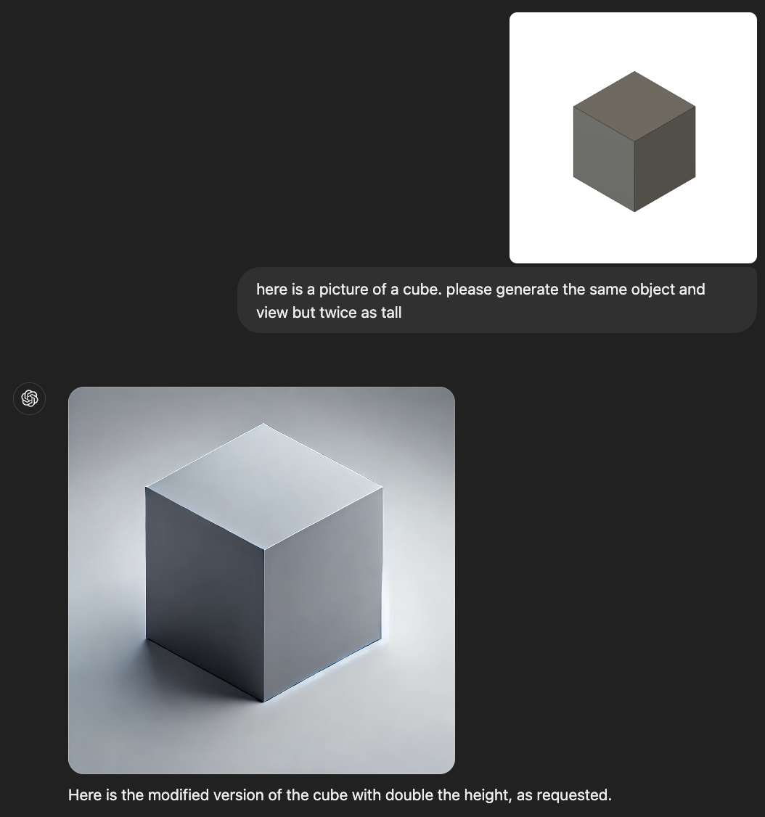
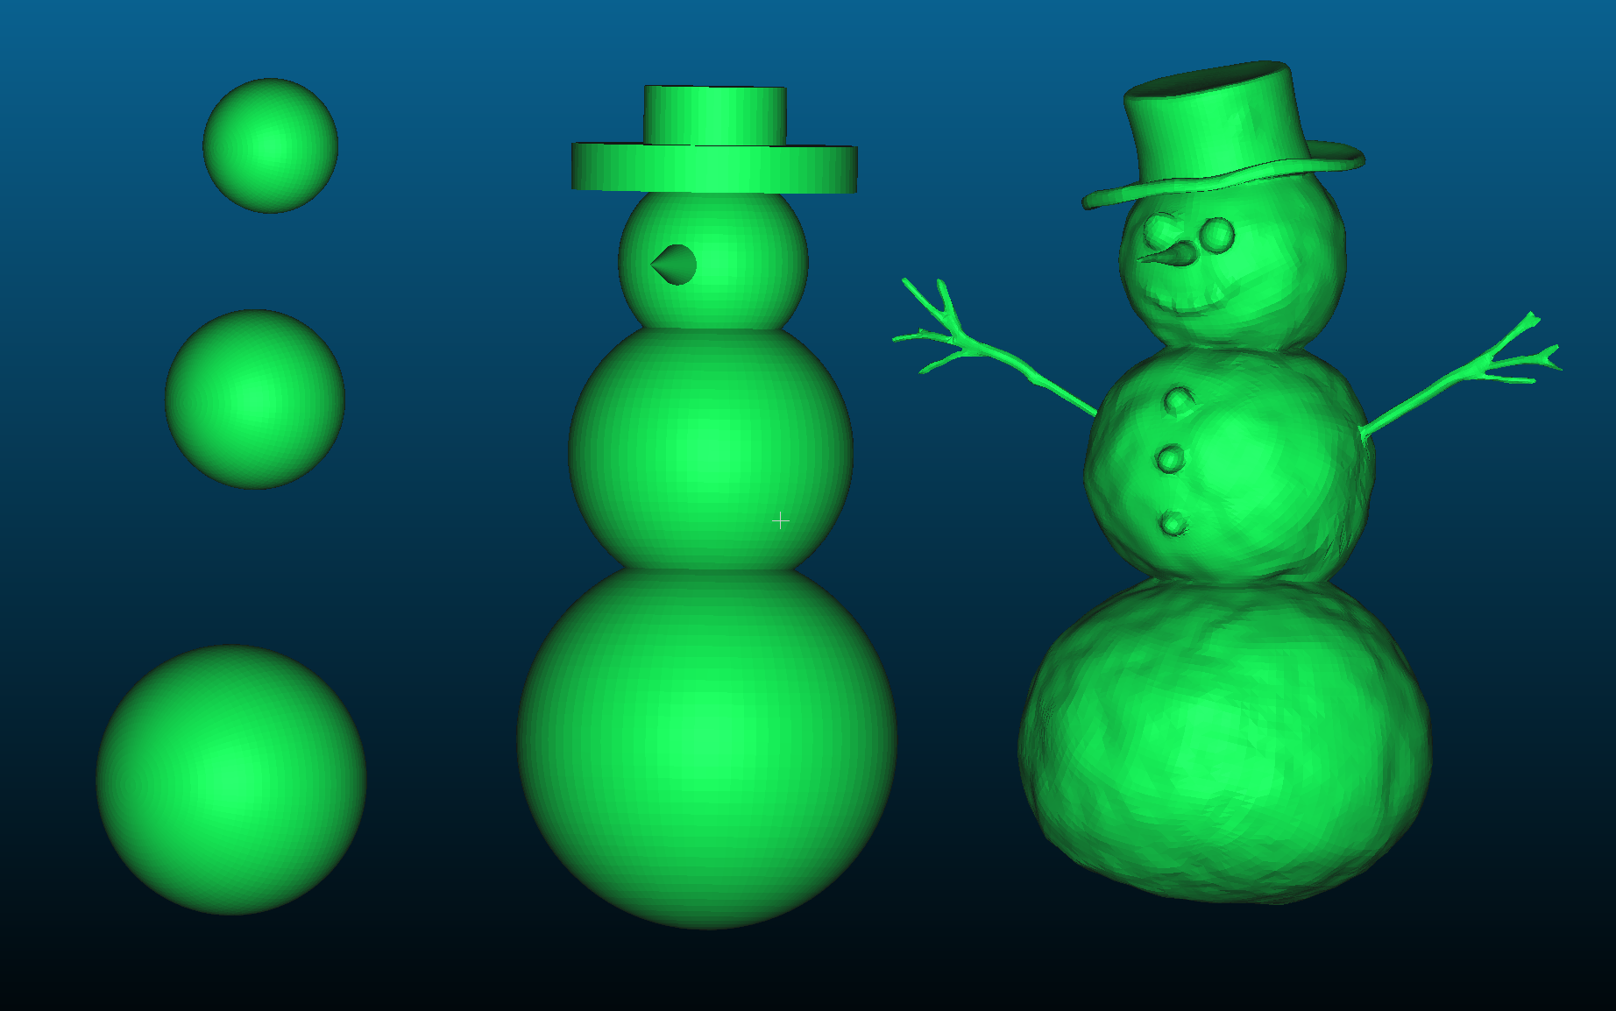

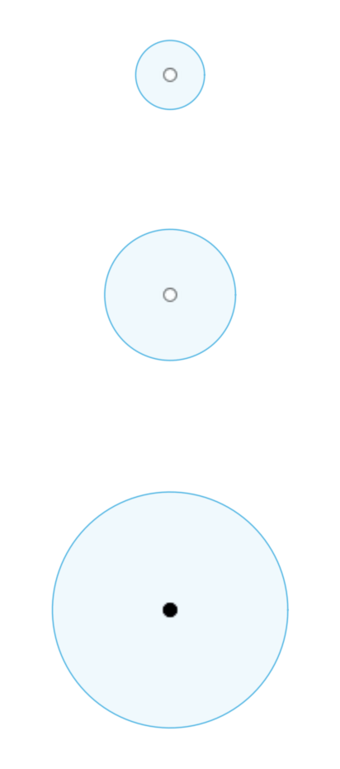
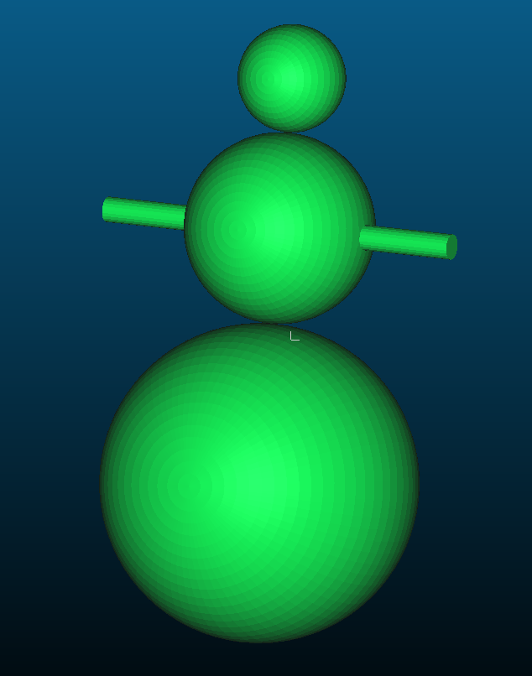

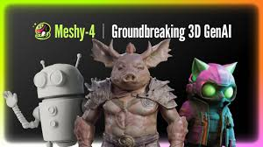
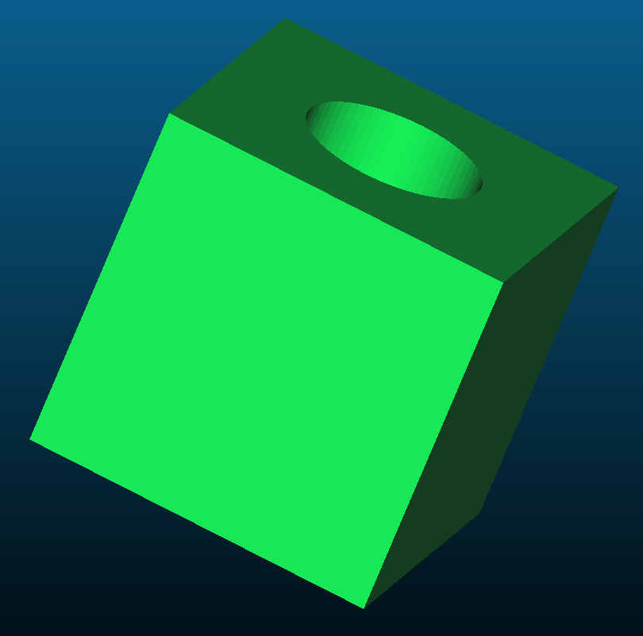
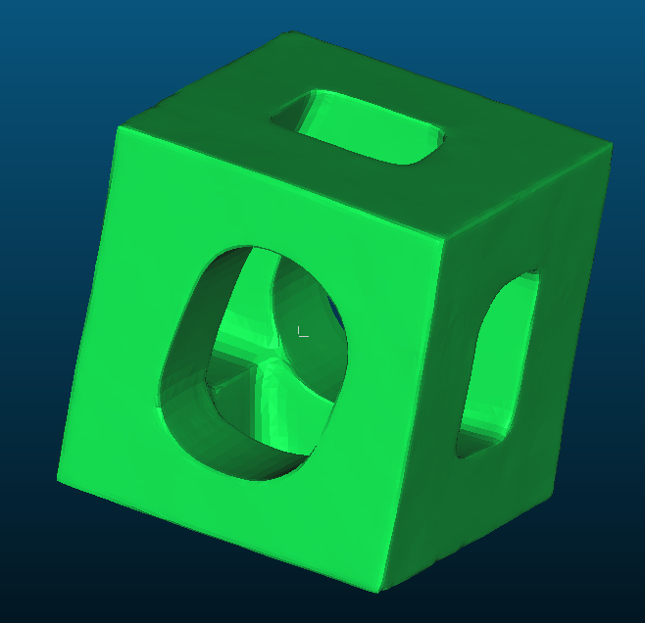
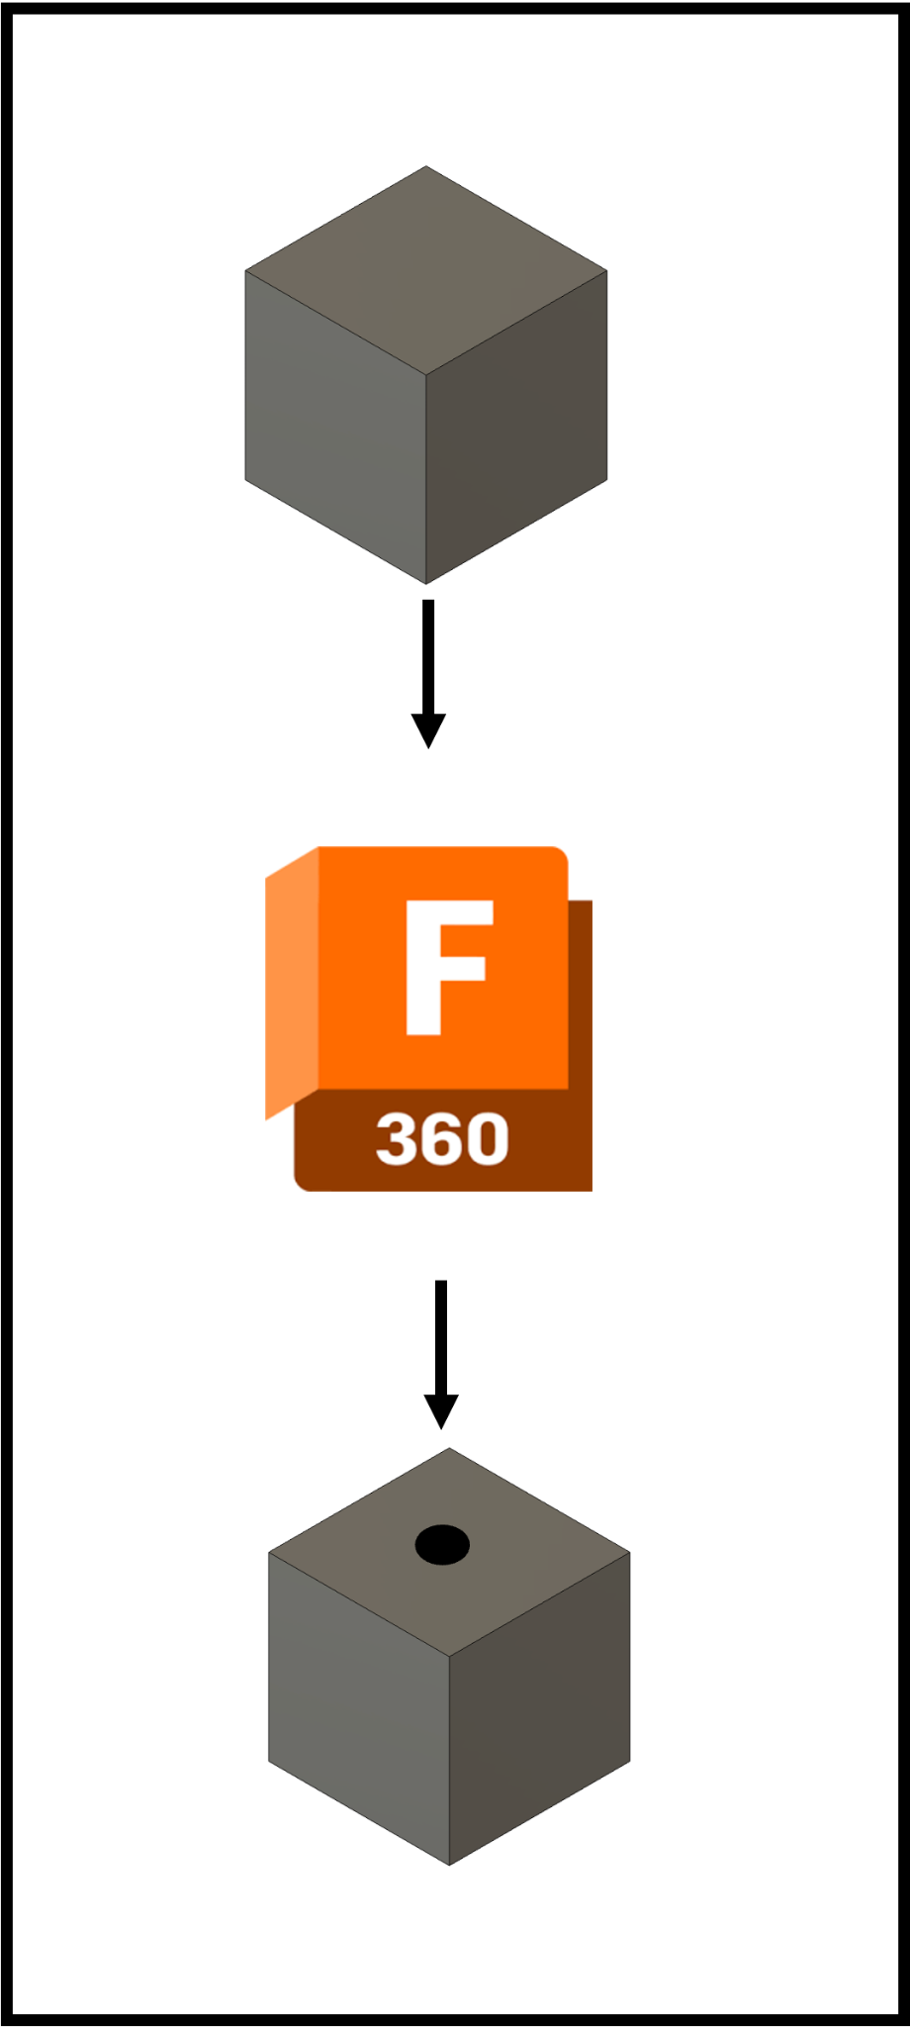


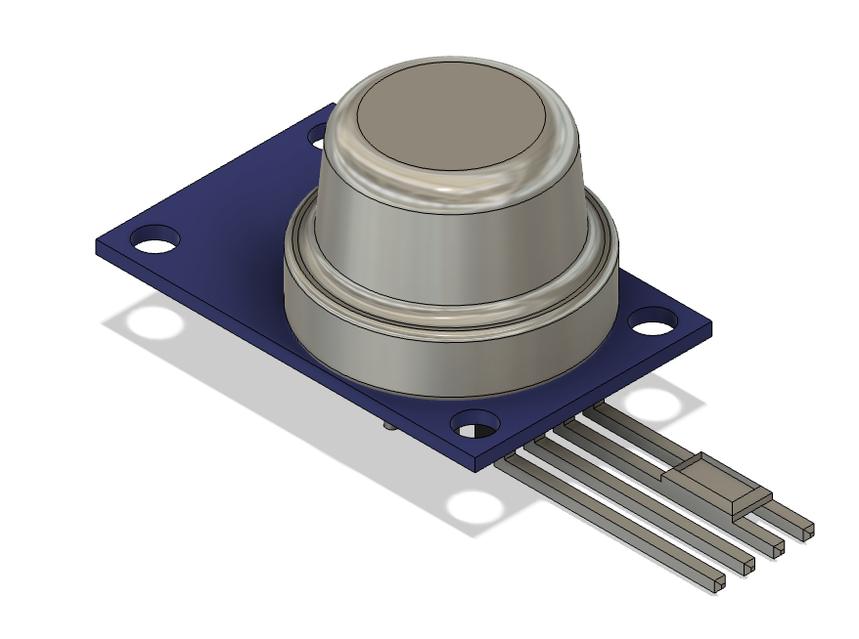
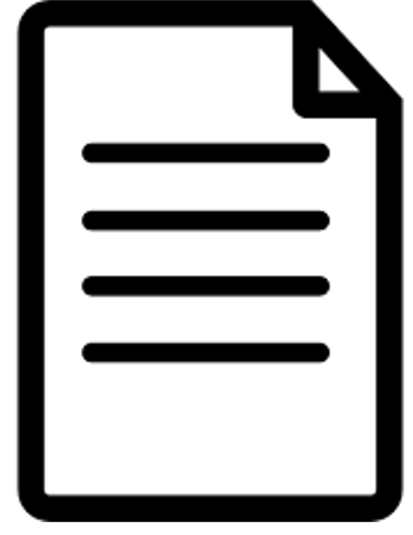
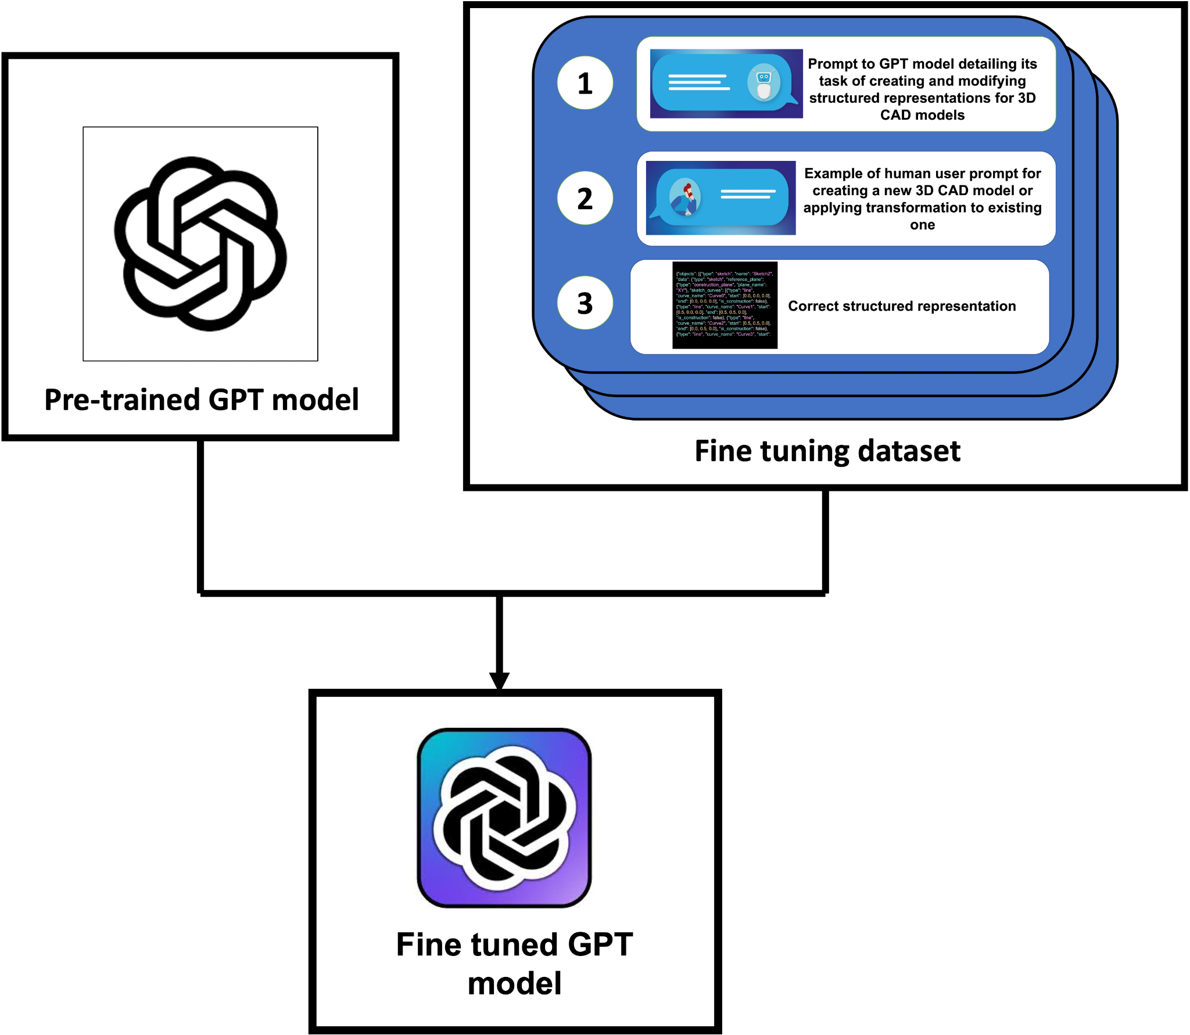

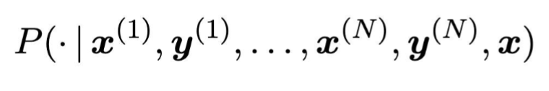

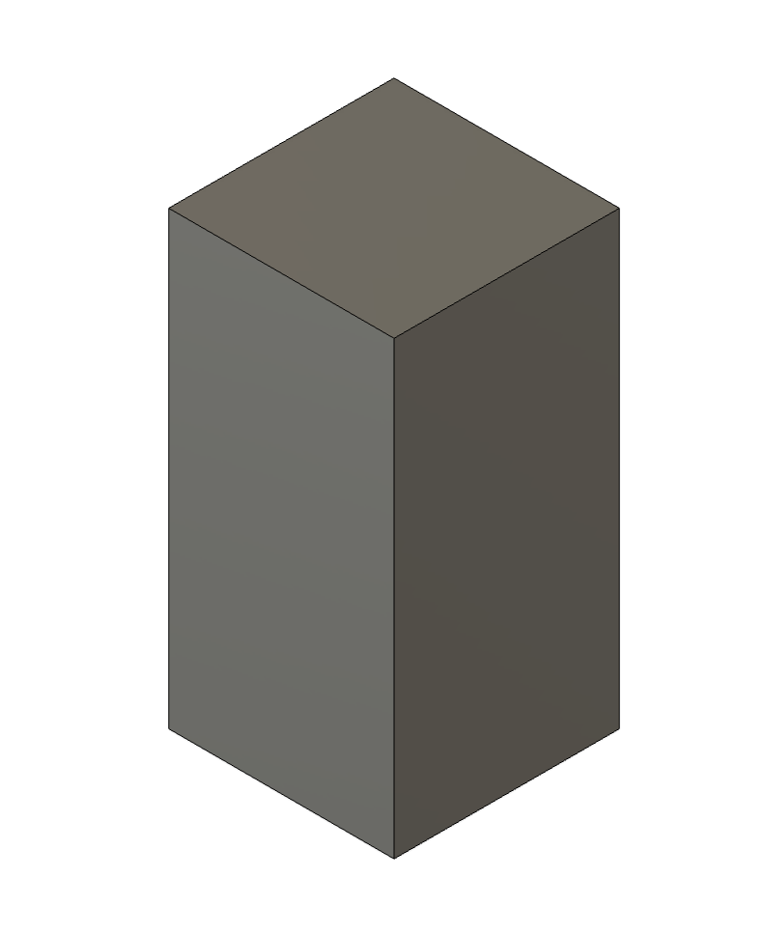
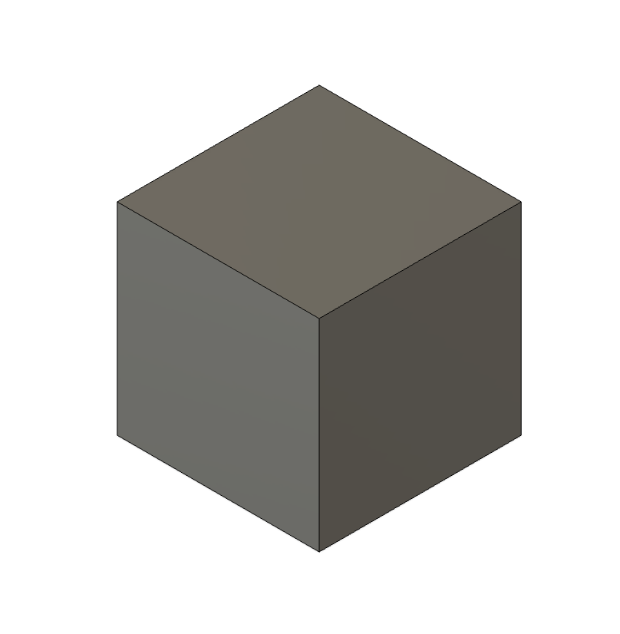
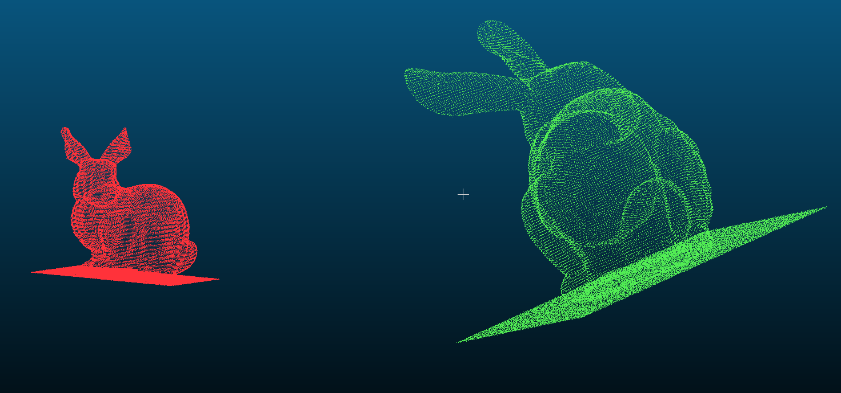
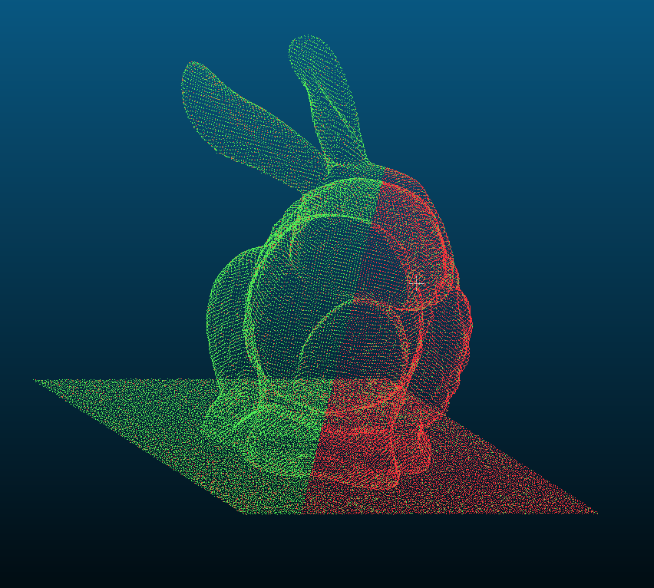
From Text to 3D: Developing a Structured Framework for CAD Design Representation
Calvin ‘Vin’ Baker, David Oluigbo, Kavya Kalathur, Akash Anand
Massachusetts Institute of Technology
Motivation
Methods
Results
Current progress with Large Language Models has led to both very creative and precise image generation.
Typical strategies for 2D understanding include decomposing images into tiles⁴ to make it a 1D array and then utilize transformers.
This does not work with 3D spatial representations as the input tokens would grow as a cubic function of length, rather than squared.
Fields such as construction, architecture, and CAD can benefit from 3D spatial generative AI.
Need precise understanding of 3D space.
Image generation models already struggle with detail.
Non LLM Baseline
Generate a Snowman
Non-LLM Baseline
Generative Baseline
Human
Ours (non fine-tuned)
GPT+MeshAI
Ours (fine-tuned)
Begin with simple rule-based baseline example:
Find keywords (pre-defined set of shapes) in text
Map dims, to each shape if dim within 3 words of keyword, else assign default, then construct object
Rule-based example limited by flexibility, understanding of spatial relationships between any 2 features in CAD
More generally, all non-generative models are limited by the following, so we pursue an LLM-based model:
Cannot adapt to dynamic, context-driven queries
Constrained by features explicitly defined during training → limited in ability to produce new CAD
Cannot synthesize realistic outputs for unseen or unique requests
GPT 4o to generate an image from a detailed description
Mesh AI to convert an image to a stl which can be rendered in fusion
Make a vertical hole through the center with diameter 25cm.
Failure of GPT to double the size of a cube
Parser
Human
Ours (non fine-tuned)
GPT+MeshAI
Ours (fine-tuned)
Background & Existing Models
{"objects": [{"type": "sketch", "name": "Sketch2", "data": {"type": "sketch", "reference_plane": {"type": "construction_plane", "plane_name": "XY"}, "sketch_curves": [{"type": "line", "curve_name": "Curve0", "start": [0.0, 0.0, 0.0], "end": [0.5, 0.0, 0.0], "is_construction": false}, {"type": "line", "curve_name": "Curve1", "start": [0.5, 0.0, 0.0], "end": [0.5, 0.5, 0.0], "is_construction": false}, {"type": "line", "curve_name": "Curve2", "start": [0.5, 0.5, 0.0], "end": [0.0, 0.5, 0.0], "is_construction": false}, {"type": "line", "curve_name": "Curve3", "start": [0.0, 0.5, 0.0], "end": [0.0, 0.0, 0.0], "is_construction": false}], "sketch_points": [], "sketch_profiles": [{"type": "sketch_profile", "profile_name": "Profile0", "profile_loops": [{"type": "sketch_profile_loop", "profile_loop_name": "ProfileLoop0", "curve_names": ["Curve0", "Curve1", "Curve2", "Curve3"], "is_outer": true}]}], "transform": [1.0, 0.0, 0.0, 0.0, 0.0, 1.0, 0.0, 0.0, 0.0, 0.0, 1.0, 0.0, 0.0, 0.0, 0.0, 1.0], "dimensions": [], "constraints": []}}, {"type": "extrude", "name": "Extrude1", "data": {"type": "extrude", "profiles": [{"type": "profile", "sketch_name": "Sketch2", "profile_name": "Profile0", "point_on_profile": [0.25, 0.25, 0.0]}], "extent": {"type": "one_side", "extent_one": {"type": "distance", "distance": 0.5, "direction": "PositiveExtentDirection"}, "taper_angle_one": 0.0}, "start": {"type": "profile_plane"}, "operation": {"type": "new_body", "body_names": ["Body1"]}}}]}
1 to 1 Representation
Model
Function
Limitations
Root Mean Square Error Comparison
Text2CAD¹
Transforms high-level descriptive language into a structural layout compatible with CAD systems
Ambiguity in natural language, introducing interpretive challenges and thus imprecise CAD output
User Request | Example Type | Baseline Model RMSE (mm) | Parsing Model RMSE (mm) | Finetuned Parsing Model RMSE (mm)
Control | Generation | 0 | 0 | 0
Cube | Generation | 0 | 0 | 0
Mug | Generation | 2.44 | 4.5 | 3.72
Snowman | Generation | 2.58 | NA* | 2.73
Make twice as tall | Edit | 15.03 | 0 | 0
Make twice as wide | Edit | 7.71 | 0 | 0
Make a vertical hole through the center | Edit | 3.25 | 0 | 0
Fillet all edges | Edit | 5.35 | 2.03 | 0
Make a smaller cube on top. | Edit | 2.71 | 4.95 | 0
Extrude a smaller cube on each side. | Edit | 3.12 | 6.35 | 1.21
Average |  | 4.22 | 2.78 | 0.77
Img2CAD
Employs vision LMs to identify structural elements from images
Struggles with spatial ambiguity; limited design accuracy
Img2CAD²
Uni3DR³
Combines geometric and semantic features for multi-modal integration and detailed 3D scene reconstructions
Computationally expensive; complex for real-time use (varying lighting, scale, complex object relationships)
Our Model
Precision in text-to-CAD mapping; flexible across textual input; maintains spatial understanding
Potentially limited performance on complex object generation
Parsed representation of a cube with a hole in the center
Dataset Generation
Prompting
Fine Tuning
Open source databases with real .f3d files.
System Prompt:
Personal prompt: “You are a CAD expert…”
Task description: “You are operating on JSON representation of …”
Examples
2 examples were used: one of showing generation and the other of showing editing.
User Prompt:
Task description: “Respond with the appropriate representation of the CAD model that fully incorporates the user request…”
Current model representation
Parsed current model if a user wants an edit
Empty if a user wants a generation
User input
Used 30 examples of highly variable and long CAD models with 10 edits and 20 generations. Note: GPT is unable to be fine tuned with structured outputs so we used prompted examples and then added structured outputs after the model was fine tuned.
BLEU Comparison
Model Number | Prompting no Structured Outputs | Prompting with Structured Outputs | Fine Tuning and Parsing with Structured Outputs
Control | 0.333 | 1 | 1
Cube | 0.213 | 0.853 | 1
Mug | 0.121 | 0.654 | 0.712
Snowman | 0.022 | 0.313 | 0.431
Average | 0.172 | 0.705 | 0.786
Structured JSON representing a 1-to-1 textual description in our PDL.
Example CAD model taken from online.
Written descriptive summary of the object
Fine tuning pipeline.
Conclusions
Model Pipeline
Evaluation
We evaluated on 10 examples that were not shown in the training dataset. Four of these were generation and six were editing.
Conclusion
Root Mean Square Error
BLEU Score
Developed a parser that can display detailed 3D space in a 1 to 1 representation
Allows for fine editing and 3D generation of CAD models that can be used for architecture, mechanical engineering, and industrial design.
Enabled by structured outputs.
Much lower RMSE compared to baseline models.
Fine tuning allows for better CAD understanding.
Suffers with complicated objects (discussed in future directions).
User Request
Prompting
{"objects": [{"type": "sketch", "name": "Sketch2", "data": {"type": "sketch", "reference_plane": {"type": "construction_plane", "plane_name": "XY"}, "sketch_curves": [{"type": "line", "curve_name": "Curve0", "start": [0.0, 0.0, 0.0], "end": [0.5, 0.0, 0.0], "is_construction": false}, {"type": "line", "curve_name": "Curve1", "start": [0.5, 0.0, 0.0], "end": [0.5, 0.5, 0.0], "is_construction": false}, {"type": "line", "curve_name": "Curve2", "start": [0.5, 0.5, 0.0], "end": [0.0, 0.5, 0.0], "is_construction": false}, {"type": "line", "curve_name": "Curve3", "start": [0.0, 0.5, 0.0], "end": [0.0, 0.0, 0.0], "is_construction": false}], "sketch_points": [], "sketch_profiles": [{"type": "sketch_profile", "profile_name": "Profile0", "profile_loops": [{"type": "sketch_profile_loop", "profile_loop_name": "ProfileLoop0", "curve_names": ["Curve0", "Curve1", "Curve2", "Curve3"], "is_outer": true}]}], "transform": [1.0, 0.0, 0.0, 0.0, 0.0, 1.0, 0.0, 0.0, 0.0, 0.0, 1.0, 0.0, 0.0, 0.0, 0.0, 1.0], "dimensions": [], "constraints": []}}, {"type": "extrude", "name": "Extrude1", "data": {"type": "extrude", "profiles": [{"type": "profile", "sketch_name": "Sketch2", "profile_name": "Profile0", "point_on_profile": [0.25, 0.25, 0.0]}], "extent": {"type": "one_side", "extent_one": {"type": "distance", "distance": 1.0 "direction": "PositiveExtentDirection"}, "taper_angle_one": 0.0}, "start": {"type": "profile_plane"}, "operation": {"type": "new_body", "body_names": ["Body1"]}}}]}
Our pipeline aims to demonstrate understanding of 3D space so we needed a loss that showcases how close two physical representations are.
The Root Mean Square Error is the average distance between sampled points on the surface of an object.
We used the Root Mean Square Error to calculate the difference between varying objects in 3D space.
We then used the BLEU⁵ Score to compare between different iterations of our model:
Prompting but no structured outputs.
Prompting with structured outputs.
Fine tuning and prompting with structured outputs.
We compared the BLEU scores of the object generation in the evaluations, not the editing as the differences in editing are not significant (i.e. treats in change in the curve name the same as doubling the length).
A lot of the BLEU score comes from structured outputs.
{"objects": [{"type": "sketch", "name": "Sketch2", "data": {"type": "sketch", "reference_plane": {"type": "construction_plane", "plane_name": "XY"}, "sketch_curves": [{"type": "line", "curve_name": "Curve0", "start": [0.0, 0.0, 0.0], "end": [0.5, 0.0, 0.0], "is_construction": false}, {"type": "line", "curve_name": "Curve1", "start": [0.5, 0.0, 0.0], "end": [0.5, 0.5, 0.0], "is_construction": false}, {"type": "line", "curve_name": "Curve2", "start": [0.5, 0.5, 0.0], "end": [0.0, 0.5, 0.0], "is_construction": false}, {"type": "line", "curve_name": "Curve3", "start": [0.0, 0.5, 0.0], "end": [0.0, 0.0, 0.0], "is_construction": false}], "sketch_points": [], "sketch_profiles": [{"type": "sketch_profile", "profile_name": "Profile0", "profile_loops": [{"type": "sketch_profile_loop", "profile_loop_name": "ProfileLoop0", "curve_names": ["Curve0", "Curve1", "Curve2", "Curve3"], "is_outer": true}]}], "transform": [1.0, 0.0, 0.0, 0.0, 0.0, 1.0, 0.0, 0.0, 0.0, 0.0, 1.0, 0.0, 0.0, 0.0, 0.0, 1.0], "dimensions": [], "constraints": []}}, {"type": "extrude", "name": "Extrude1", "data": {"type": "extrude", "profiles": [{"type": "profile", "sketch_name": "Sketch2", "profile_name": "Profile0", "point_on_profile": [0.25, 0.25, 0.0]}], "extent": {"type": "one_side", "extent_one": {"type": "distance", "distance": 0.5, "direction": "PositiveExtentDirection"}, "taper_angle_one": 0.0}, "start": {"type": "profile_plane"}, "operation": {"type": "new_body", "body_names": ["Body1"]}}}]}
Spatial Object
GPT 4o Structured Outputs
Reconstructed Spatial Object
Future Directions
Parsed object
Parsed object
Currently, limitations include the inability to generate or edit very complicated items. This is due to lengthy text needed to represent objects in a 1 to 1 fashion. This opens doors to “step by step” thinking of generation and editing. For example, when a snowman is created, it first creates a large circle, then a medium circle, and then a small circle. Next, one would add a hat, nose, and then arms. This is a very sequential process. Therefore, we anticipate that once could use planning agents to first come up with a sequential plan of how to generate or edit an object, and then only add a singular CAD feature at a time. This would comply with out current PDL as our overall JSON structure is a Timeline of different Features of the feature tree of a CAD.
Our model has the following steps: 1) Input user request + spatial object
2) Prompting + Object Parsing 3) GPT 4o Structured Outputs 4) Modified Object Parsing 5) Modified Spatial Object Reconstruction
Registration in cloud compare using the iterative closest point algorithm to get alignment before the root mean square error is calculated.
¹Mohammad Sadil Khan, Sankalp Sinha, Talha Uddin Sheikh, Didier Stricker, Sk Aziz Ali, and Muhammad Zeshan Afzal. Text2cad: Generating sequential cad models from beginnerto-expert level text prompts, 2024.
²Yang You, Mikaela Angelina Uy, Jiaqi Han, Rahul Thomas, Haotong Zhang, Suya You, and Leonidas Guibas. Img2cad: Reverse engineering 3d cad models from images through vlm-assisted conditional factorization, 2024
³Xiaoyi Dong Yuhang Zang Qiong Liu Tao Chu, Pan Zhang and Jiaqi Wang. Unified scene representation and reconstruction for 3d large language models, 2024.
⁴Wenshan Wu, Shaoguang Mao, Yadong Zhang, Yan 718 Xia, Li Dong, Lei Cui, and Furu Wei. 2024. Mind’s 719 eye of llms: Visualization-of-thought elicits spa- 720tial reasoning in large language models. Preprint, 721 arXiv:2404.03622.
⁵Kishore Papineni, Salim Roukos, Todd Ward, and Wei-Jing Zhu. Bleu: a method for automatic evaluation of machine translation, 2002.
* Used a value of 10 for the average.

